Slide 1
Web API
Application Programing Interface

Slide 2
Topic
What is Web api
Web API components
How web api works
Data Formats
Assignment

Slide 3
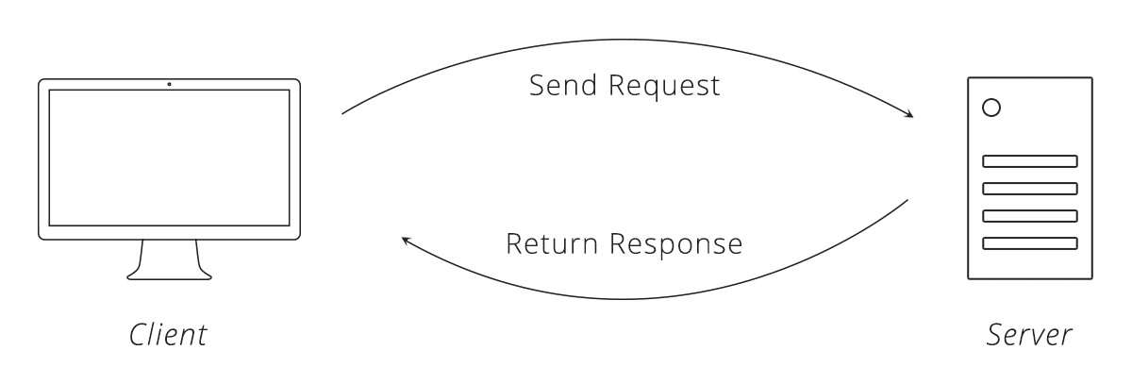
What is Web api
Web API is a framework for building HTTP services that can be consumed by a broad range of clients including browsers, mobiles, iphone and tablets.
Web API is the great framework for exposing your data and service to different-different devices.

Slide 4
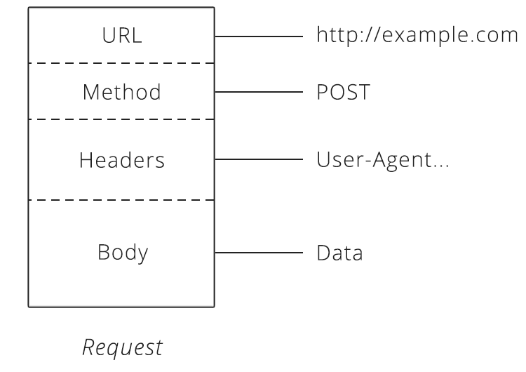
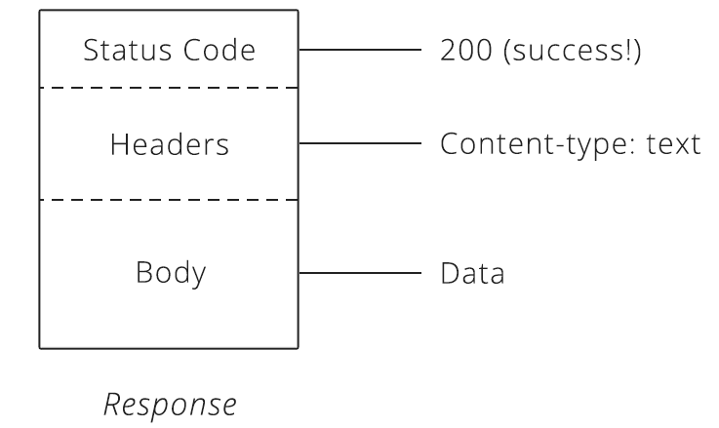
Web API components
HTTP Request
HTTP Response

Slide 5
Web API components
URL
URLs become an easy way for the client to tell the server which things it wants to interact with, called resources.
Method
The method request tells the server what kind of action the client wants the server to take in. The four most commonly seen in API’s are:
GET — Asks the server to retrieve a resource. POST — Asks the server to create a new resource. PUT — Asks the server to edit/update an existing resource. DELETE — Asks the server to delete a resource.
Headers
Headers provide meta-information about a request.
Body
The request body contains the data the client wants to send the server.
Status code
Status code are three-digit numbers.

Slide 6
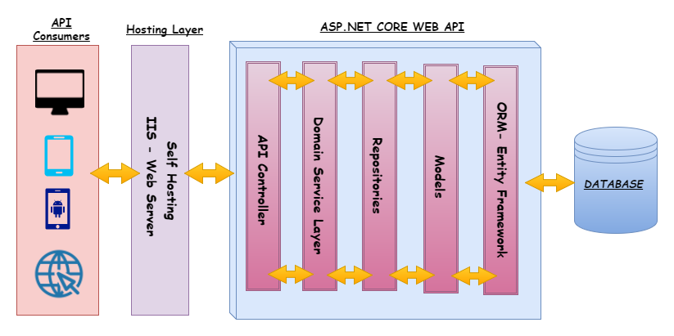
How web api works

Slide 7

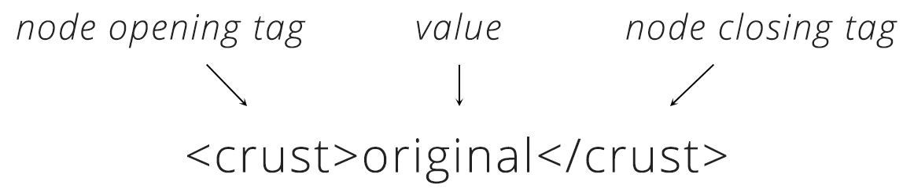
Data Formats
The most common formats found in APIs are JSON and XML.
JSON is very simple format that has two pieces: key and value.
XML provides a few building blocks. The main block is called a node. XML always starts with a root node, inside there are more “child” nodes. The name of the node tells us the attribute of the order and the data inside is the actual details.

Slide 8
assignment
Create Project web api
Create Controller that contain method for GET, POST, PUT, DELETE

